Slide 1


Computer Networks
Week-4: Lecture1 (Chapter1)
Security in Computer Networks
Subhan Ullah, PhD
subhan.ullah@nu.edu.pk
BS(Computer Science) Spring-2022

Slide 2

Chapter 1: roadmap
What is the Internet?
What is a protocol?
Network edge: hosts, access network, physical media
Network core: packet/circuit switching, internet structure
Performance: loss, delay, throughput
Protocol layers, service models
Security in Computer Network
History
Notes:
Segue: from performance to security.
Wartime, business, and love affair are the commonly cited human needs for secure communication. .

Slide 3
Network security
Internet not originally designed with (much) security in mind
original vision: “a group of mutually trusting users attached to a transparent network” ☺
Internet protocol designers playing “catch-up”
security considerations in all layers!
We now need to think about:
how bad guys can attack computer networks
how we can defend networks against attacks
how to design architectures that are immune to attacks

Slide 4

Bad guys: packet interception
packet “sniffing”:
broadcast media (shared Ethernet, wireless)
promiscuous network interface reads/records all packets (e.g., including passwords!) passing by
A
C
src:B dest:A payload
B
Notes:
Wireshark software used for our end-of-chapter labs is a (free) packet-sniffer.
Active and passive attacks.

Slide 5
Bad guys: fake identity
IP spoofing: injection of packet with false source address
A
C
src:B dest:A payload
B

Slide 6
Bad guys: denial of service
Denial of Service (DoS): attackers make resources (server, bandwidth) unavailable to legitimate traffic by overwhelming resource with bogus traffic
1. select target
2. break into hosts around the network (see botnet)
3. send packets to target from compromised hosts
target

Slide 7
Security: (overview)
Goals of the Lecture:
understand principles of network security:
cryptography and its many uses beyond “confidentiality”
authentication
message integrity

Slide 8
What is network security?
confidentiality: only sender, intended receiver should “understand” message contents
sender encrypts message
receiver decrypts message
authentication: sender, receiver want to confirm identity of each other
message integrity: sender, receiver want to ensure message not altered (in transit, or afterwards) without detection
access and availability: services must be accessible and available to users

Slide 9



Friends and enemies: Alice, Bob, Trudy
well-known in network security world
Bob, Alice (lovers!) want to communicate “securely”
Trudy (intruder) may intercept, delete, add messages
Alice
channel
data, control messages
Bob
secure
sender
secure
receiver
data
data
Trudy

Slide 10
Friends and enemies: Alice, Bob, Trudy
Who might Bob and Alice be?
… well, real-life Bobs and Alices!
Web browser/server for electronic transactions (e.g., on-line purchases)
on-line banking client/server
DNS servers
BGP routers exchanging routing table updates
other examples?
Notes:
Border Gateway Protocol (BGP): refers to a gateway protocol that enables the internet to exchange routing information between autonomous systems (AS).

Slide 11
There are bad guys (and girls) out there!
Q: What can a “bad guy” do?
A: A lot!
eavesdrop: intercept messages
actively insert messages into connection
impersonation: can fake (spoof) source address in packet (or any field in packet)
hijacking: “take over” ongoing connection by removing sender or receiver, inserting himself in place
denial of service: prevent service from being used by others (e.g., by overloading resources)

Slide 12
Lines of defense:
authentication: proving you are who you say you are
cellular networks provides hardware identity via SIM card; no such hardware assist in traditional Internet
confidentiality: via encryption
integrity checks: digital signatures prevent/detect tampering
access restrictions: password-protected VPNs
firewalls: specialized “middleboxes” in access and core networks:
off-by-default: filter incoming packets to restrict senders, receivers, applications
detecting/reacting to DOS attacks
… lots more on security (throughout, Chapter 8)

Slide 13
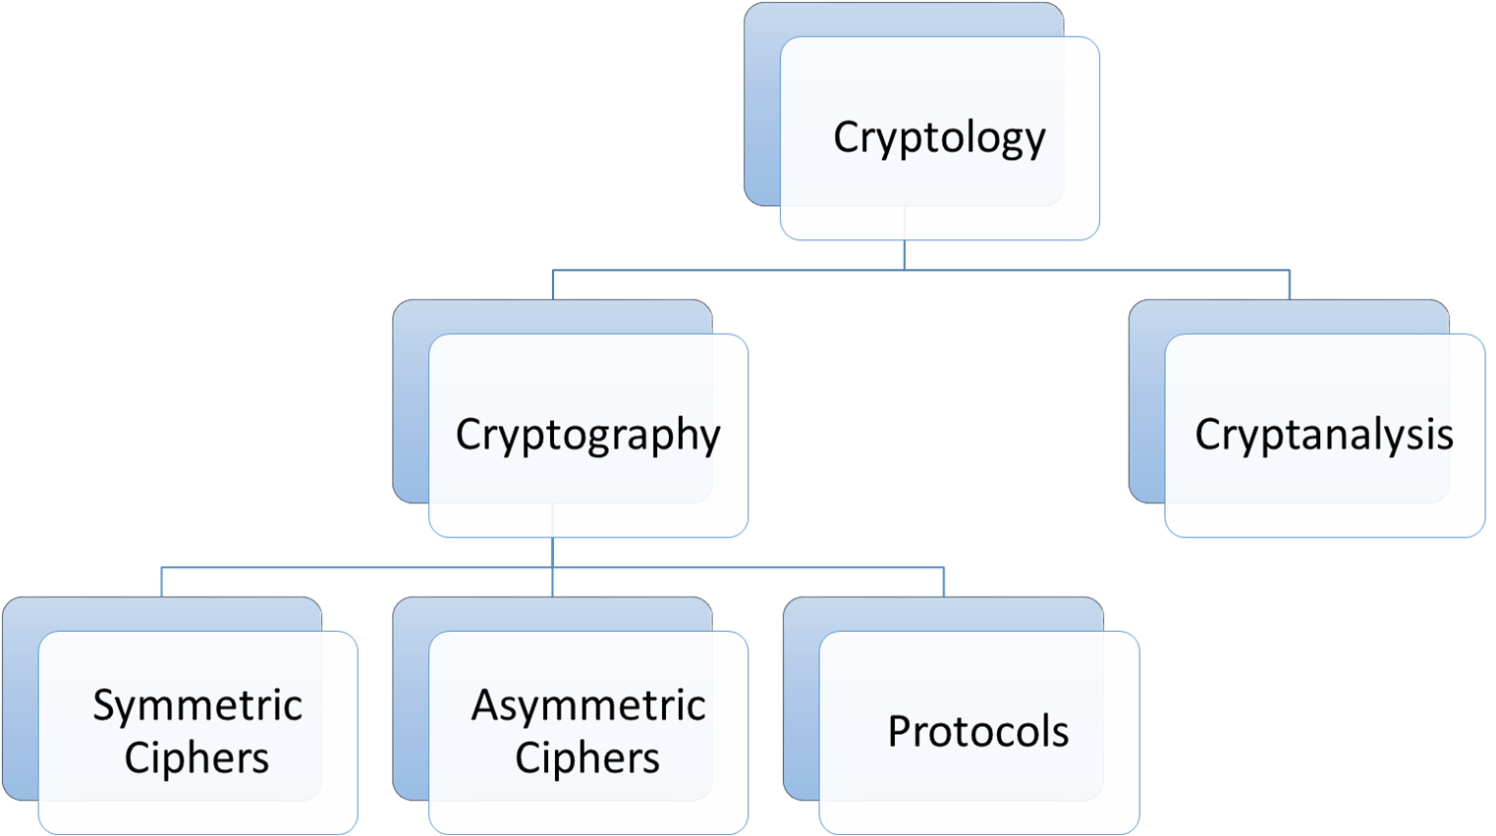
Cryptography overview
Cryptology
The most general term for the crypto field
Cryptography
Crypt means secret and graphy means writing
The science of secret writing with the goal of hiding the meaning of a message
Cryptanalysis
The science of breaking cryptosystems
The only way and an integral part of cryptology to assure that a cryptosystem is secure

Slide 14
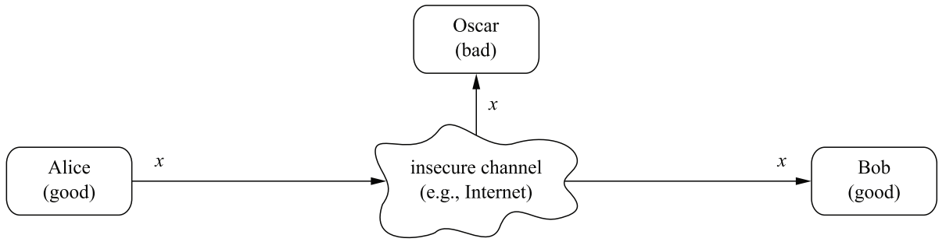
Motivation (cryptography)
Communication over an insecure channel (between Alice and Bob)
Confidentiality is required:
Data (x) need to be secure from unauthorized access (e.g., from eavesdropping attack by Oscar or Trudy)
Non-repudiation, Authentication, Integrity are also required
Source: Paar, Christof, and Jan Pelzl. Understanding cryptography: a textbook for students and practitioners. Springer Science & Business Media, 2009

Slide 15
The language of cryptography
Alice’s
encryption
key
Bob’s
decryption
key
K
A
K
B
plaintext
encryption
algorithm
ciphertext
decryption
algorithm
plaintext
m: plaintext message
K_{A}(m): ciphertext, encrypted with key K_{A}
m = K_{B}(K_{A}(m))

Slide 16
Symmetric key cryptography (overview)
Symmetric cryptographic schemes are also called shared-key, secret-key and single-key schemes
Parties use the same secret key for encryption and decryption
The encryption and decryption function are very similar (easy to implement)
Symmetric cryptography offers a powerful solution to prevent eavesdropping
No need to transfer key with messages
The set of all possible keys is called key space
Encryption/decryption algorithm is publicly known and key is secret
Modern symmetric algorithm such as AES are very secure, fast and are in widespread use

Slide 17
Symmetric key cryptography
K
K
S
S
plaintext
encryption
algorithm
ciphertext
decryption
algorithm
plaintext
K (m)
S
symmetric key crypto: Bob and Alice share same (symmetric) key: K
e.g., key is knowing substitution pattern in mono alphabetic substitution cipher
Q: how do Bob and Alice agree on key value?

Slide 18
Simple encryption scheme
substitution cipher: substituting one thing for another
monoalphabetic cipher: substitute one letter for another
plaintext: abcdefghijklmnopqrstuvwxyz
ciphertext: mnbvcxzasdfghjklpoiuytrewq
e.g.:
Plaintext: bob. i love you. alice
ciphertext: nkn. s gktc wky. mgsbc
Encryption key: mapping from set of 26 letters
to set of 26 letters
Notes:
Old one: Caesar cipher by Julius Caesar.
Polyalphabetic encryption

Slide 19
Symmetric key crypto: DES
DES: Data Encryption Standard
US encryption standard [NIST 1993]
56-bit symmetric key, 64-bit plaintext input
block cipher with cipher block chaining
how secure is DES?
DES Challenge: 56-bit-key-encrypted phrase can be decrypted (brute force) in less than a day
no known good analytic attack
making DES more secure:
3DES: encrypt 3 times with 3 different keys

Slide 20
AES: Advanced Encryption Standard
symmetric-key NIST standard, replaced DES (Nov 2001)
processes data in 128 bit blocks
128, 192, or 256 bit keys
brute force decryption (try each key) taking 1 sec on DES, takes 149 trillion years for AES

Slide 21
Breaking an encryption scheme
cipher-text only attack: Trudy has ciphertext she can analyze
two approaches:
brute force: search through all keys
statistical analysis
known-plaintext attack: Trudy has plaintext corresponding to ciphertext
e.g., in monoalphabetic cipher, Trudy determines pairings for a,l,i,c,e,b,o,
chosen-plaintext attack: Trudy can get ciphertext for chosen plaintext

Slide 22
Limitations of symmetric key cryptography
Key distribution problem: Sending a key directly over the communication channel is a convenient way for key distribution
However, symmetric key cryptosystem requires a secure channel
Dealing with large number of keys (manageability of keys)
If each pair of users needs a separate pair of keys in a network with n users, then there will be n ( n-1 ) keys 2
Each user needs to store (n- 1) keys securely
Some smarter approaches are used but they have single point of failure
No protection against cheating by users (e.g., Alice or Bob)
Non-repudiation is not possible
Hard to prove authenticity, and dictionary attacks due to static keys

Slide 23

Public Key Cryptography
symmetric key crypto:
requires sender, receiver know shared secret key
Q: how to agree on key in first place (particularly if never “met”)?
public key crypto
radically different approach [Diffie-Hellman76, RSA78]
sender, receiver do not share secret key
public encryption key known to all
private decryption key known only to receiver
https://gomindsight.com/insights/blog/what-are-the-7-layers-of-security/

Slide 24
Public Key Cryptography
+
Bob’s public key
K
B
-
Bob’s private key
K
B
plaintext
message, m
encryption
algorithm
ciphertext
decryption
algorithm
plaintext
+
-
+
K (m)
m = K (K (m))
B
B
B
Wow - public key cryptography revolutionized 2000-year-old (previously only symmetric key) cryptography!
similar ideas emerged at roughly same time, independently in US and UK (classified)

Slide 25
Public key encryption algorithms
requirements:
+
.
-
.
1
need K ( ) and K ( ) such that
B
B
-
+
K (K (m)) = m
B
B
+
2
given public key K , it should be impossible to compute private key K
B
-
B
RSA: Rivest, Shamir, Adelson algorithm

Slide 26
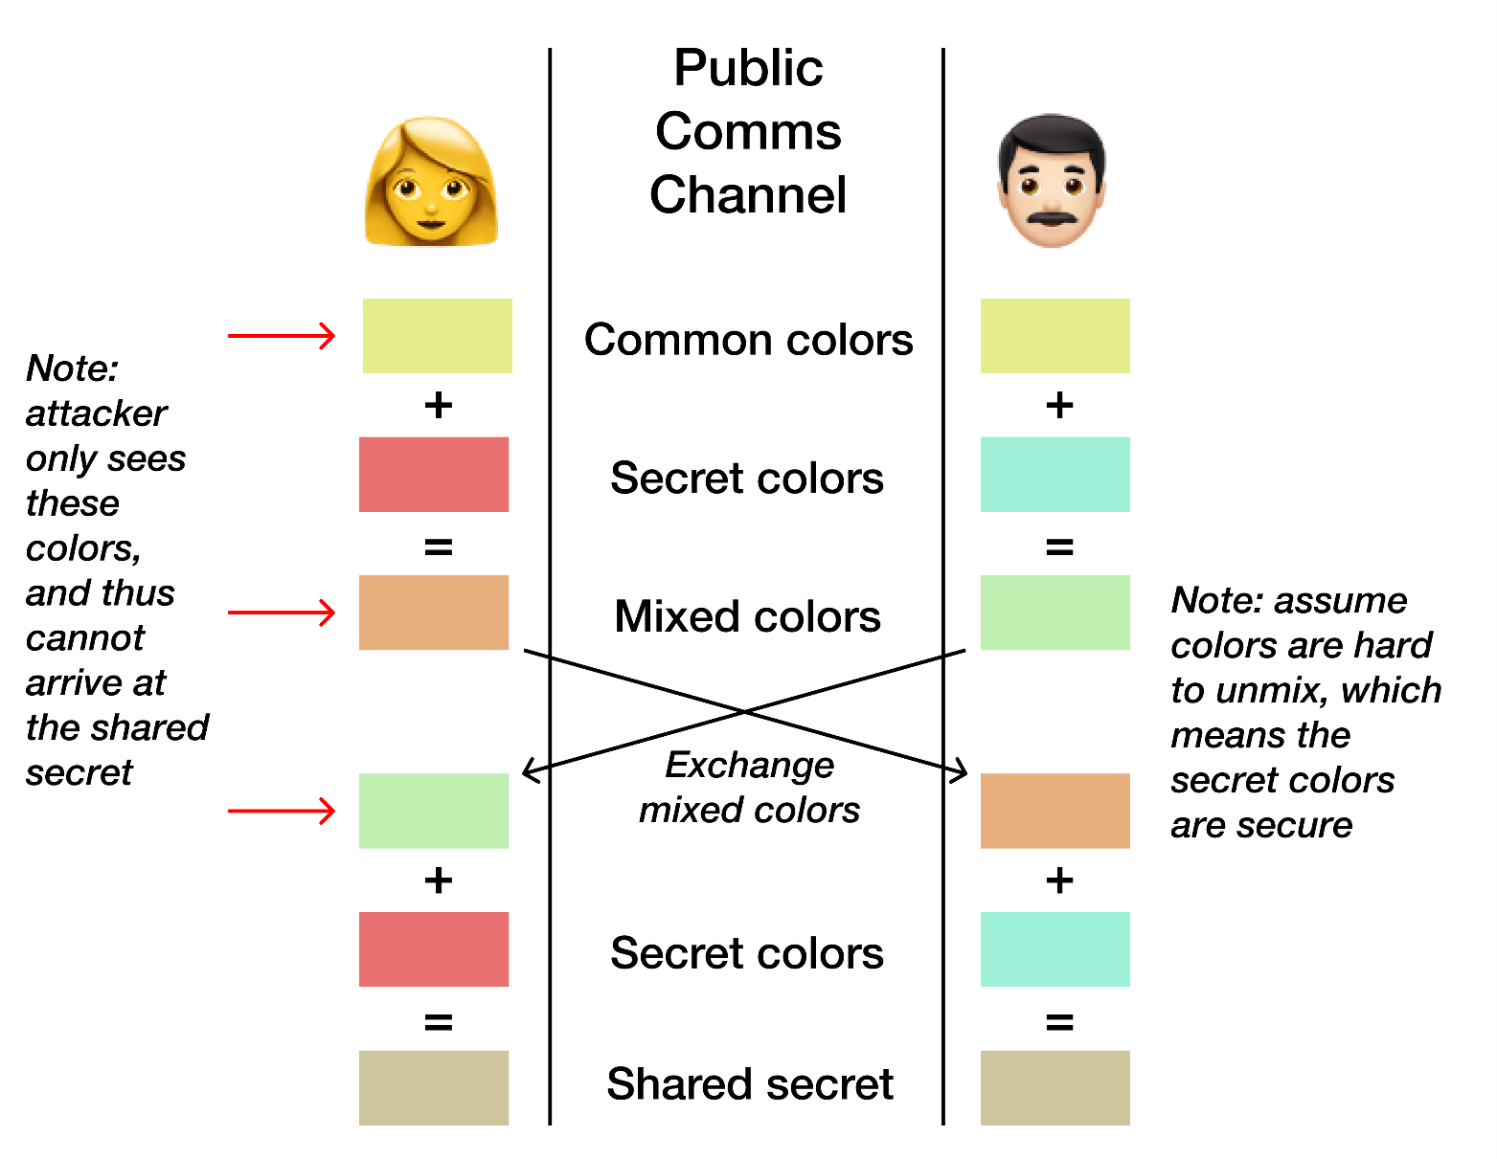
Diffie-Hellman key exchange (The big picture)
Alice
Bob
https://pencilflip.medium.com/diffie-hellman-key-exchange-7dba8e9e59d6

Slide 27
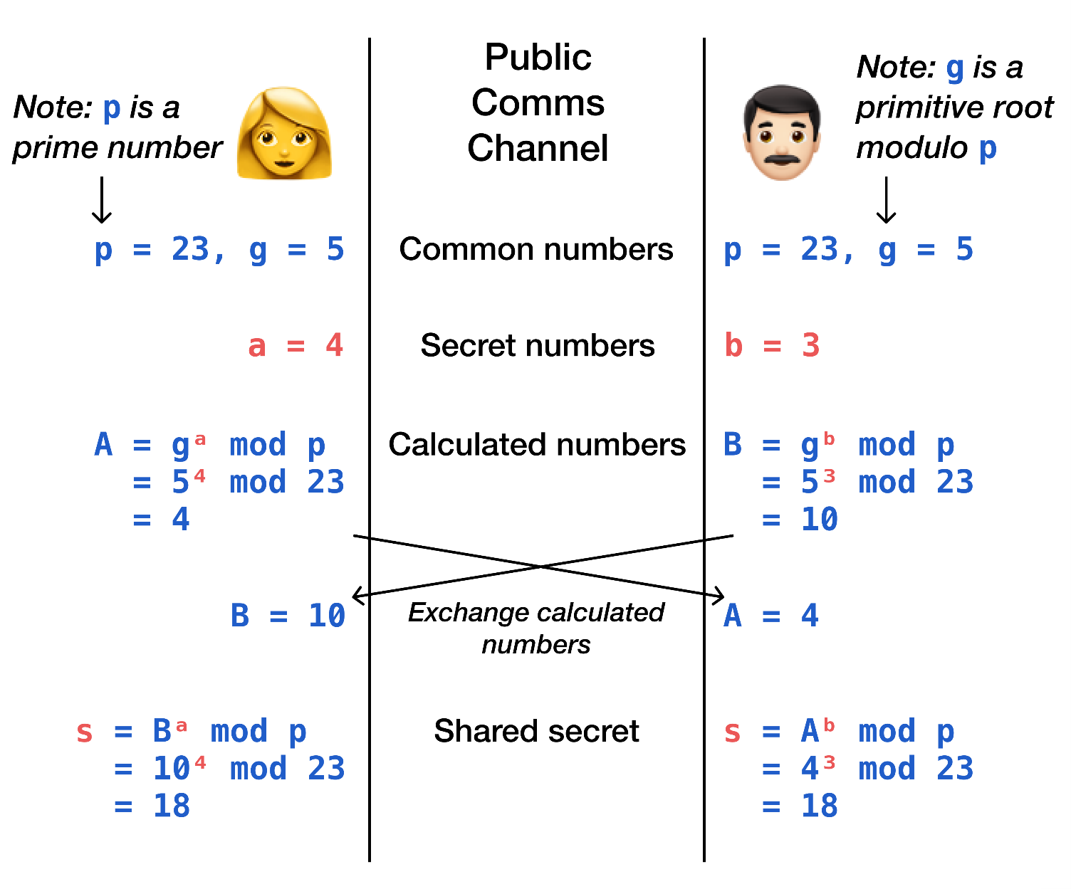
Cryptographic explanation of Diffie-Hellman KE
Alice
Bob
https://pencilflip.medium.com/diffie-hellman-key-exchange-7dba8e9e59d6

Slide 28
Cryptanalysis (recap)
The art and science of breaking crypto codes is called cryptanalysis
Attack Vectors
Security implementation
Cryptographic variable
Algorithms
Data
Social engineering
Trying all possible combinations (e.g., to find a Password)
The attacker systematically checks all possible passwords and passphrases until the correct one is found

Slide 29
Brute-force attack (Three factors)
Cost
How much money do you have for the computing devices
Time
How much time will be required
Computing power/ capability
Moore’s Law: which states that processor speeds, or overall processing power for computers will double every two years
Moore’s law depends on key space and work factor
Work factor is the amount of time required to break a cryptographic system

Slide 30
Authentication
Goal: Bob wants Alice to “prove” her identity to him
Protocol ap1.0: Alice says “I am Alice”
“I am Alice”
failure scenario??

Slide 31
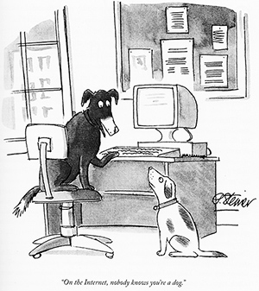
Authentication
Goal: Bob wants Alice to “prove” her identity to him
Protocol ap1.0: Alice says “I am Alice”
in a network, Bob can not “see” Alice, so Trudy simply declares herself to be Alice
“I am Alice”

Slide 32
Authentication: another try
Goal: Bob wants Alice to “prove” her identity to him
Protocol ap2.0: Alice says “I am Alice” in an IP packet containing her source IP address
Alice’s
IP address
“I am Alice”
failure scenario??

Slide 33
Authentication: another try
Goal: Bob wants Alice to “prove” her identity to him
Protocol ap2.0: Alice says “I am Alice” in an IP packet containing her source IP address
Trudy can create
a packet “spoofing”
Alice’s address
Alice’s
IP address
“I am Alice”

Slide 34
Authentication: a third try
Goal: Bob wants Alice to “prove” her identity to him
Protocol ap3.0: Alice says “I am Alice” Alice says “I am Alice” and sends her secret password to “prove” it.
Alice’s
IP addr
Alice’s
password
“I am Alice”
failure scenario??
Alice’s
IP addr
OK

Slide 35
Authentication: a third try
Goal: Bob wants Alice to “prove” her identity to him
Protocol ap3.0: Alice says “I am Alice” Alice says “I am Alice” and sends her secret password to “prove” it.
playback attack: Trudy records Alice’s packet
and later
plays it back to Bob
Alice’s
IP addr
Alice’s
password
“I am Alice”
Alice’s
IP addr
Alice’s
password
“I am Alice”
Alice’s
IP addr
OK

Slide 36
Authentication: a modified third try
Goal: Bob wants Alice to “prove” her identity to him
Protocol ap3.0: Alice says “I am Alice” Alice says “I am Alice” and sends her encrypted secret password to “prove” it.
Alice’s
IP addr
encrypted
password
“I am Alice”
failure scenario??
Alice’s
IP addr
OK

Slide 37
Authentication: a modified third try
Goal: Bob wants Alice to “prove” her identity to him
Protocol ap3.0: Alice says “I am Alice” Alice says “I am Alice” and sends her encrypted secret password to “prove” it.
Alice’s
IP addr
encrypted
password
“I am Alice”
playback attack still works: Trudy records Alice’s packet
and later plays it back to Bob
Alice’s
IP addr
encrypted
password
“I am Alice”
Alice’s
IP addr
OK

Slide 38
Authentication: a fourth try
Goal: avoid playback attack
nonce: number (R) used only once-in-a-lifetime
protocol ap4.0: to prove Alice “live”, Bob sends Alice nonce, R
Alice must return R, encrypted with shared secret key
“I am Alice”
R
K (R)
Bob know Alice is live, and only Alice knows key to encrypt nonce, so it must be Alice!
A-B
Failures, drawbacks?

Slide 39
Authentication: ap5.0
ap4.0 requires shared symmetric key - can we authenticate using public key techniques?
ap5.0: use nonce, public key cryptography
“I am Alice”
R
Bob computes
+
-
-
K
(K (R)) = R
K (R)
A
A
A
and knows only Alice could have the private key, that encrypted R such that
Send me your public key
+
K
+
-
A
K
A
(K (R)) = R
A

Slide 40
Authentication: ap5.0 – there’s still a flaw!
man (or woman) in the middle attack: Trudy poses as Alice (to Bob) and as Bob (to Alice)
I am Alice
I am Alice
?
R
-
K (R)
T
R
Where are mistakes made here?
Send me your public key
-
+
K (R)
K
Bob computes
A
T
+
-
Send me your public key
K
(K (R)) = R,
+
T
T
K
authenticating
Trudy as Alice
A
Trudy recovers m:
+
+
-
+
K (m)
Trudy recovers Bob’s m:
m = K (K (m))
Bob sends a personal message, m to Alice
-
+
K (m)
T
T
m = K (K (m))
A
T
A
A
sends m to Alice encrypted with Alice’s public key
and she and Bob meet a week later in person and discuss m, not knowing Trudy knows m

Slide 41
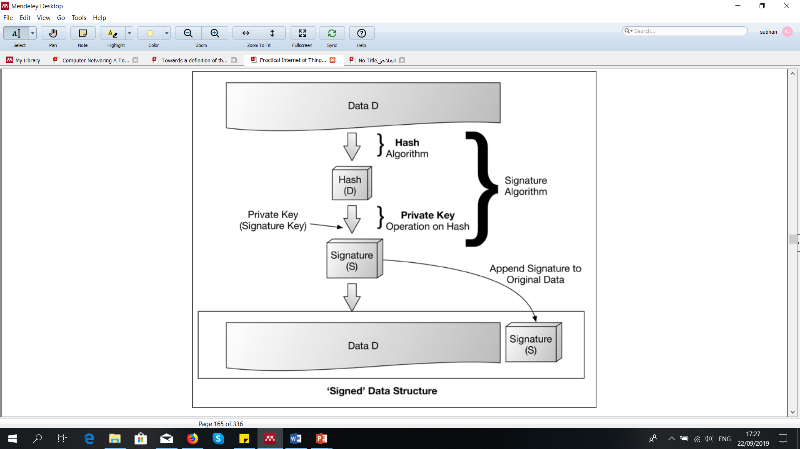
Digital Signature
Digital signature provides integrity, authentication, data origin, and nonrepudiation protections
Unique to the signer
The signature accompany the message ( signed message)
Signature verification using appropriate key
The data was, indeed, signed by a known or declared key
The data has not been corrupted or tampered
If the verification of signature fails, then the verifier should not trust the data integrity or whether it has originated from the right source
If the signature verification is successful, the data was indeed, signed by a known or declared key

Slide 42

Digital signatures (Example)
cryptographic technique analogous to hand-written signatures:
sender (Bob) digitally signs document: he is document owner/creator.
verifiable, nonforgeable: recipient (Alice) can prove to someone that Bob, and no one else (including Alice), must have signed document
simple digital signature for message m:
Bob signs m by encrypting with his private key K_{B}, creating “signed” message, K_{B}⁻(m)
-
-
Bob’s message, m
K
Bob’s private
key
m,K
(m)
B
B
Dear Alice
Oh, how I have missed you. I think of you all the time! …(blah blah blah)
Bob
Dear Alice
Oh, how I have missed you. I think of you all the time! …(blah blah blah)
Bob
Public key
encryption
algorithm
-
K
(m)
B

Slide 43
Digital signatures
-
suppose Alice receives msg m, with signature: m, K_{B}(m)
Alice verifies m signed by Bob by applying Bob’s public key K_{B} to K_{B}(m) then checks K_{B}(K_{B}(m) ) = m.
If K_{B}(K_{B}(m) ) = m, whoever signed m must have used Bob’s private key
+
-
+
-
+
-
Alice thus verifies that:
Bob signed m
no one else signed m
Bob signed m and not m’
non-repudiation:
Alice can take m, and signature K_{B}(m)to court and prove that Bob signed m
-

Slide 44
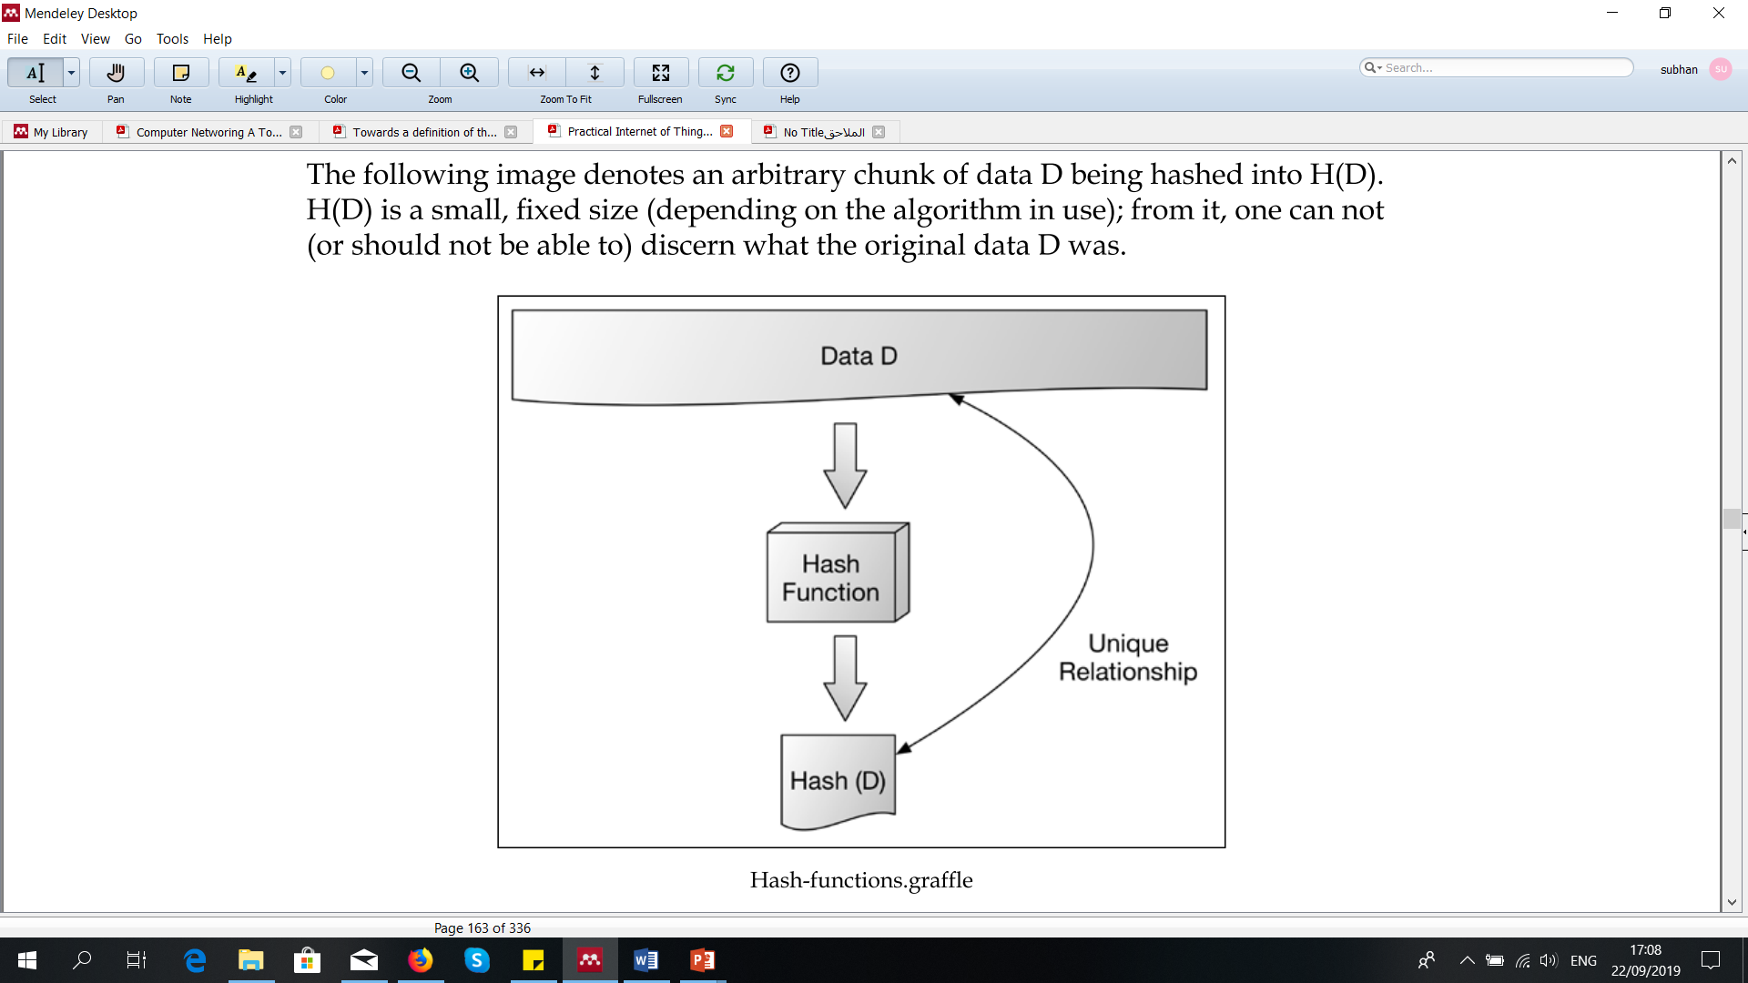
Cryptographic Hash algorithm
Hash is one-way and irreversible function
Hash is collision free function
Take variable sized inputs and create fixed size output or hashes
Produce a random looking value (e.g., hash value)
Protecting passwords and other authentication by hashing them
Checking the integrity of a large data
Preforming asymmetric Digital signatures
Foundation for message authentication codes (MAC)

Slide 45
Message digests
computationally expensive to public-key-encrypt long messages
goal: fixed-length, easy- to-compute digital “fingerprint”
apply hash function H to m, get fixed size message digest, H(m)
large
message
m
H: Hash
Function
H(m)
Hash function properties:
many-to-1
produces fixed-size msg digest (fingerprint)
given message digest x, computationally infeasible to find m such that x = H(m)

Slide 46
Digital signature = signed message digest
Bob sends digitally signed message:
Alice verifies signature, integrity of digitally signed message:
large
message
m
H: Hash
Function
H(m)
encrypted
message digest
-
K_{B}(H(m))
digital
signature
(encrypt)
Bob’s
private
key
large
message
m
-
K
B
digital
signature
(decrypt)
Bob’s
public
key
+
encrypted
message digest
H: Hash
function
K
B
+
-
K_{B}(H(m))
H(m)
H(m)
?
equal

Slide 47
Hash function algorithms
MD5 hash function widely used (RFC 1321)
computes 128-bit message digest in 4-step process.
arbitrary 128-bit string x, appears difficult to construct msg m whose MD5 hash is equal to x
SHA-1 is also used
US standard [NIST, FIPS PUB 180-1]
160-bit message digest

Slide 48
Authentication: ap5.0 – let’s fix it!!
Recall the problem: Trudy poses as Alice (to Bob) and as Bob (to Alice)
I am Alice
I am Alice
?
R
-
K (R)
T
R
Where are mistakes made here?
Send me your public key
-
+
K (R)
K
Bob computes
A
T
+
-
Send me your public key
K
(K (R)) = R,
+
T
T
K
authenticating
Trudy as Alice
A
Trudy recovers m:
+
-
+
+
Trudy recovers Bob’s m:
m = K (K (m))
K (m)
Bob sends a personal message, m to Alice
-
+
K (m)
T
T
m = K (K (m))
A
T
A
A
sends m to Alice encrypted with Alice’s public key
and she and Bob meet a week later in person and discuss m, not knowing Trudy knows m

Slide 49
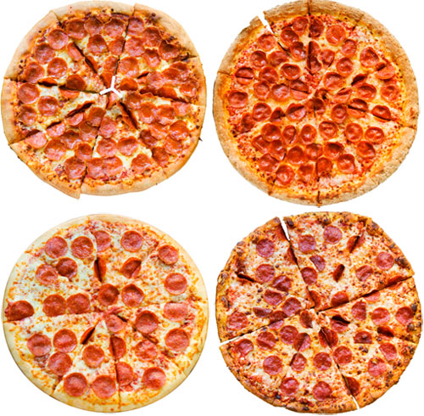

Need for certified public keys
motivation: Trudy plays pizza prank on Bob
Trudy creates e-mail order: Dear Pizza Store, Please deliver to me four pizzas. Thank you, Bob
Trudy signs order with her private key
Trudy sends order to Pizza Store
Trudy sends to Pizza Store her public key, but says it’s Bob’s public key
Pizza Store verifies signature; then delivers four pizzas to Bob
Bob doesn’t even like Pizza

Slide 50
Public key Certification Authorities (CA)
certification authority (CA): binds public key to particular entity, E
entity (person, website, router) registers its public key with CE provides “proof of identity” to CA
CA creates certificate binding identity E to E’s public key
certificate containing E’s public key digitally signed by CA: CA says “this is E’s public key”
Bob’s
public
key
digital
signature
(encrypt)
+
+
K
K
B
B
CA’s
private
key
-
certificate for Bob’s public key, signed by CA
Bob’s
identifying information
K
CA

Slide 51
Public key Certification Authorities (CA)
when Alice wants Bob’s public key:
gets Bob’s certificate (Bob or elsewhere)
apply CA’s public key to Bob’s certificate, get Bob’s public key
+
digital
signature
(decrypt)
Bob’s
public
key
K
+
B
K
B
CA’s
public
key
+
K
CA

Slide 52
Public key cryptosystem (advantage/limitations)
Advantages of asymmetric or public key cryptography
Two keys required (public and private)
Keys are more convenient to share among parties
Easy to manage the keys
Can use for generating digital signature (to achieve non-repudiation)
Provide better security
But asymmetric cryptography has also some limitations
Slower and requires more CPU power
Huge issues if private key is exposed
Man-in-the-Middle and Brute-force attack are possible
Decryption is not possible if a private key is lost

Slide 53
Chapter 1: summary
We’ve covered a “ton” of material!
Internet overview
what’s a protocol?
network edge, access network, core
packet-switching versus circuit-switching
Internet structure
performance: loss, delay, throughput
layering, service models
security
history
You now have:
context, overview, vocabulary, “feel” of networking
more depth, detail, and fun to follow!

Slide 54
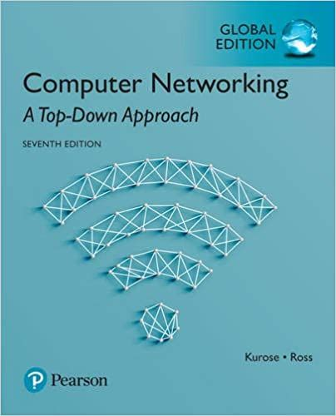
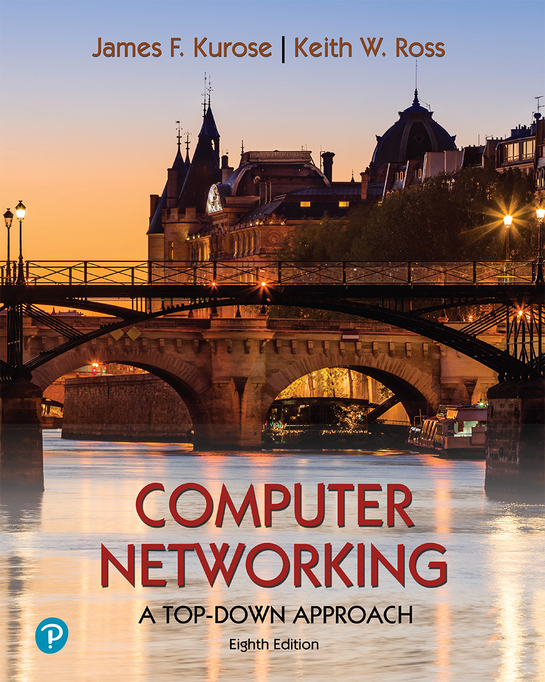
Thank You All
☺
?
A note on the origin of these ppt slides:
All material copyright 1996-2020 J.F Kurose and K.W. Ross, All Rights Reserved
These slides are freely provided by the book authors and it represents a lot of work on their part. We would like to thank J.F Kurose and K.W. Ross.

Slide 55
Chapter 1: roadmap
What is the Internet?
What is a protocol?
Network edge: hosts, access network, physical media
Network core: packet/circuit switching, internet structure
Performance: loss, delay, throughput
Security
Protocol layers, service models
History

Slide 56
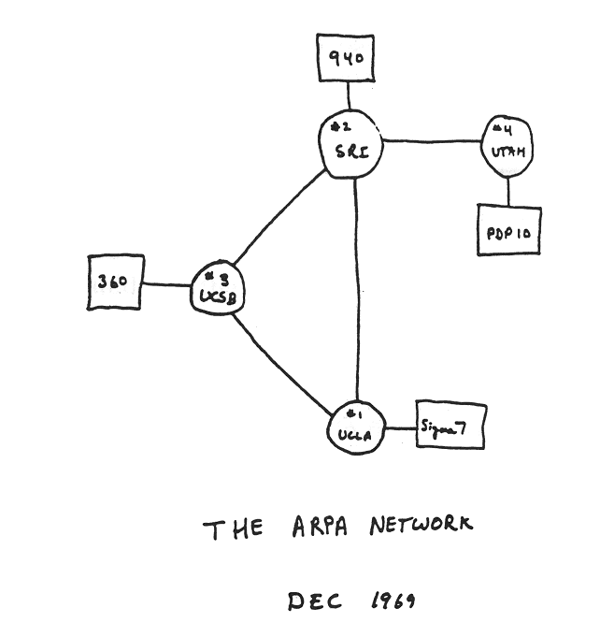
Internet history: Home work
1961-1972: Early packet-switching principles
1961: Kleinrock - queueing theory shows effectiveness of packet-switching
1964: Baran - packet-switching in military nets
1967: ARPAnet conceived by Advanced Research Projects Agency
1969: first ARPAnet node operational
1972:
ARPAnet public demo
NCP (Network Control Protocol) first host-host protocol
first e-mail program
ARPAnet has 15 nodes

Slide 57
Internet history
1972-1980: Internetworking, new and proprietary networks
1970: ALOHAnet satellite network in Hawaii
1974: Cerf and Kahn - architecture for interconnecting networks
1976: Ethernet at Xerox PARC
late70’s: proprietary architectures: DECnet, SNA, XNA
1979: ARPAnet has 200 nodes
Cerf and Kahn’s internetworking principles:
minimalism, autonomy - no internal changes required to interconnect networks
best-effort service model
stateless routing
decentralized control
define today’s Internet architecture

Slide 58
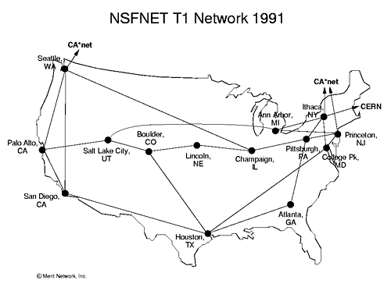
Internet history
1980-1990: new protocols, a proliferation of networks
1983: deployment of TCP/IP
1982: smtp e-mail protocol defined
1983: DNS defined for name-to-IP-address translation
1985: ftp protocol defined
1988: TCP congestion control
new national networks: CSnet, BITnet, NSFnet, Minitel
100,000 hosts connected to confederation of networks

Slide 59
Internet history
1990, 2000s: commercialization, the Web, new applications
early 1990s: ARPAnet decommissioned
1991: NSF lifts restrictions on commercial use of NSFnet (decommissioned, 1995)
early 1990s: Web
hypertext [Bush 1945, Nelson 1960’s]
HTML, HTTP: Berners-Lee
1994: Mosaic, later Netscape
late 1990s: commercialization of the Web
late 1990s – 2000s:
more killer apps: instant messaging, P2P file sharing
network security to forefront
est. 50 million host, 100 million+ users
backbone links running at Gbps

Slide 60
Internet history
2005-present: scale, SDN, mobility, cloud
aggressive deployment of broadband home access (10-100’s Mbps)
2008: software-defined networking (SDN)
increasing ubiquity of high-speed wireless access: 4G/5G, WiFi
service providers (Google, FB, Microsoft) create their own networks
bypass commercial Internet to connect “close” to end user, providing “instantaneous” access to social media, search, video content, …
enterprises run their services in “cloud” (e.g., Amazon Web Services, Microsoft Azure)
rise of smartphones: more mobile than fixed devices on Internet (2017)
~18B devices attached to Internet (2017)

Slide 61
Thank You All
☺
?
A note on the origin of these ppt slides:
All material copyright 1996-2020 J.F Kurose and K.W. Ross, All Rights Reserved
These slides are freely provided by the book authors and it represents a lot of work on their part. We would like to thank J.F Kurose and K.W. Ross.

